Slide 1
L’integrazione di Cloud e IoT e le infrastrutture di rete a banda larga 19 Dicembre 2017
Antonio Pescapè, pescape@unina.it

Slide 2
Agenda
Il Paradigma CloudIoT
A. Botta, W. de Donato, V. Persico, A. Pescapè, Integration of Cloud Computing and Internet of Things: a Survey, Future Generation Computer Systems, Elsevier
La connettività e le prestazioni di rete delle Cloud pubbliche
V. Persico, A. Botta, P. Marchetta, A. Montieri, A. Pescapè, On the performance of the wide-area networks interconnecting public-cloud datacenters around the globe, Computer Networks 112: 67-83 (2017)
V. Persico, P. Marchetta, A. Botta, A. Pescapè, Measuring network throughput in the cloud: The case of Amazon EC2, Computer Networks 93: 408-422 (2015)
Notes:
Il piano I4.0 prevede tra le tecnologie abilitanti il cloud...

Slide 3
CLOUD COMPUTING

Slide 4
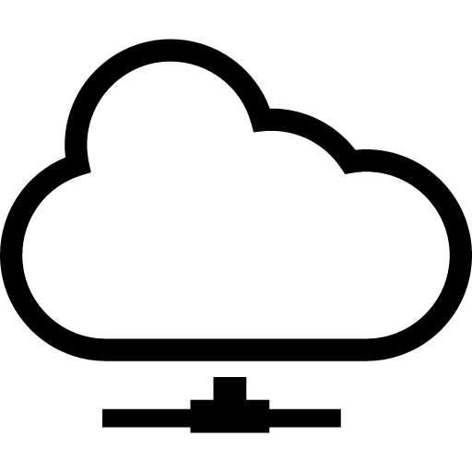
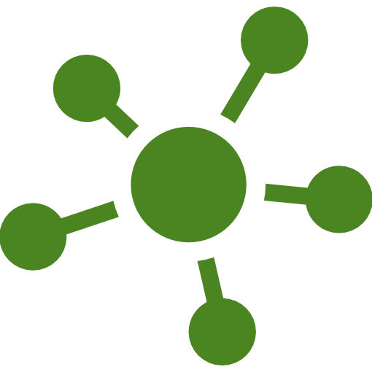
Cloud Computing
Pay-as-you-go resources
No upfront investments
Real-time provisioning
Resource autoscaling
Ubiquitous access
XaaS: everything as a service
SaaS, PaaS, IaaS

Slide 5
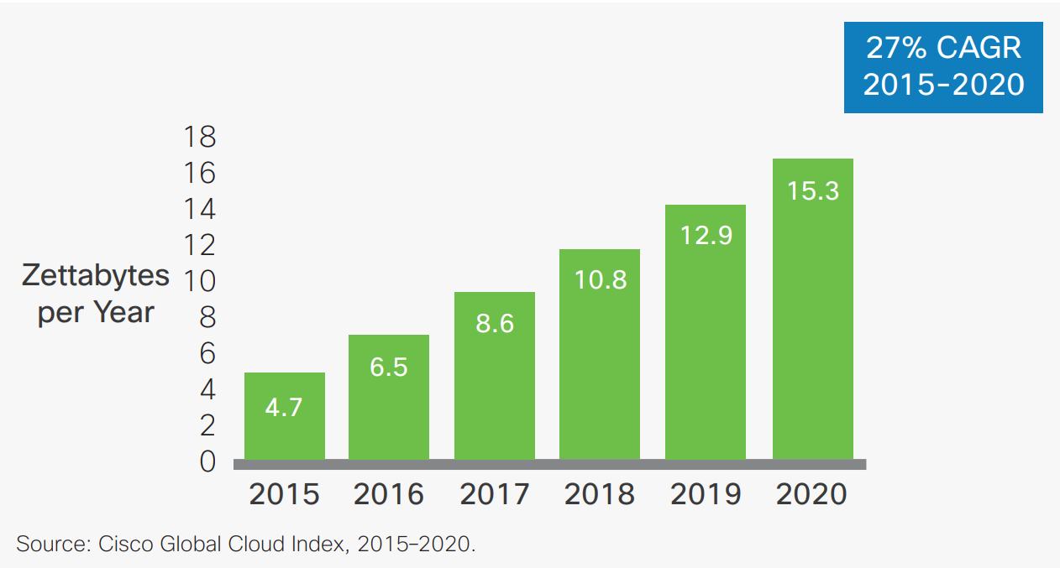
Global Datacenter IP traffic Growth
Notes:
Traffico IP dei datacenter che cresce tanto anche per...

Slide 6
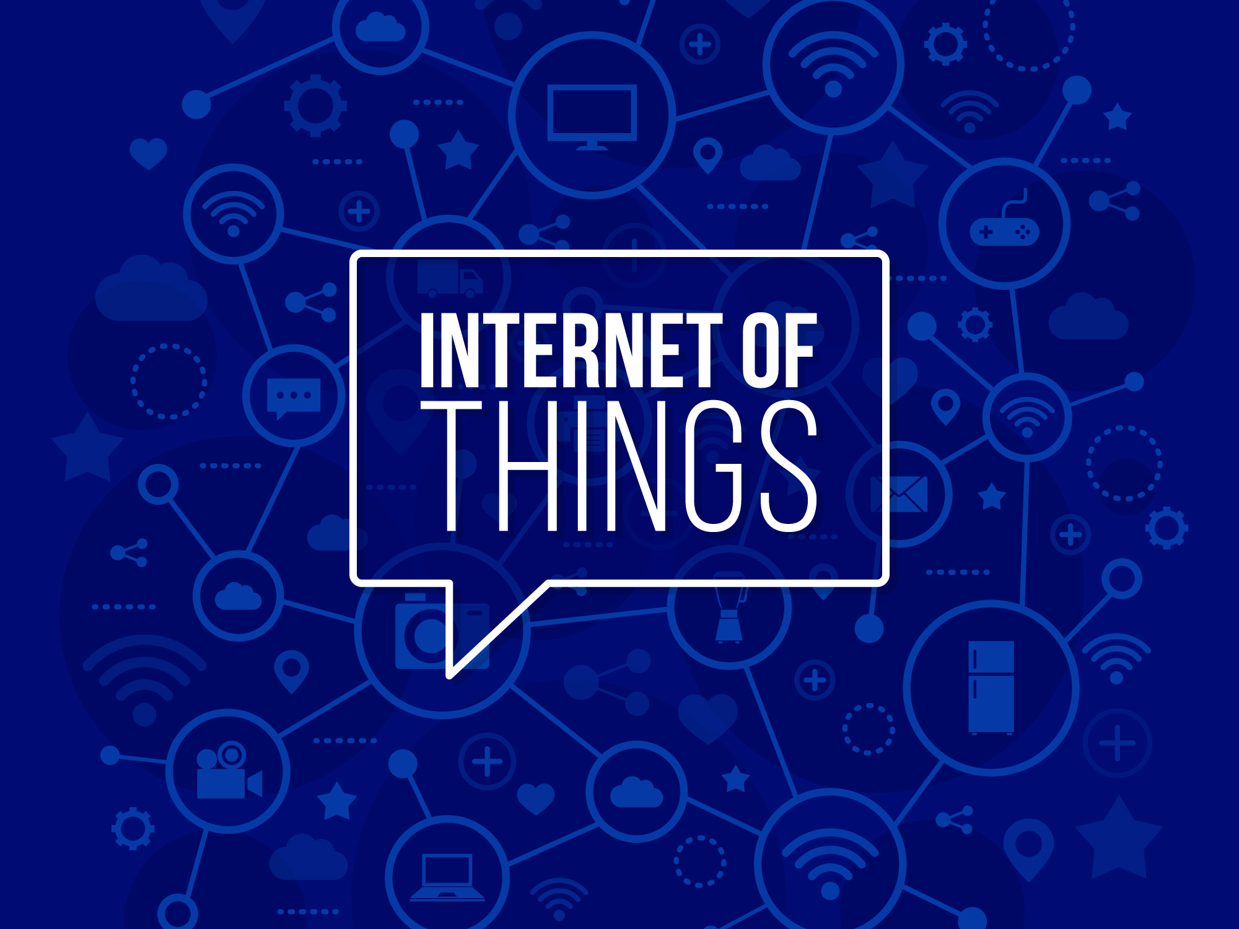
Notes:
Internet delle cose, ovvero l’estensione della rete per cui i nostri oggetti acquisiscono intelligenza comunicando dati su se stessi e sull’ambiente che li circonda,

Slide 7
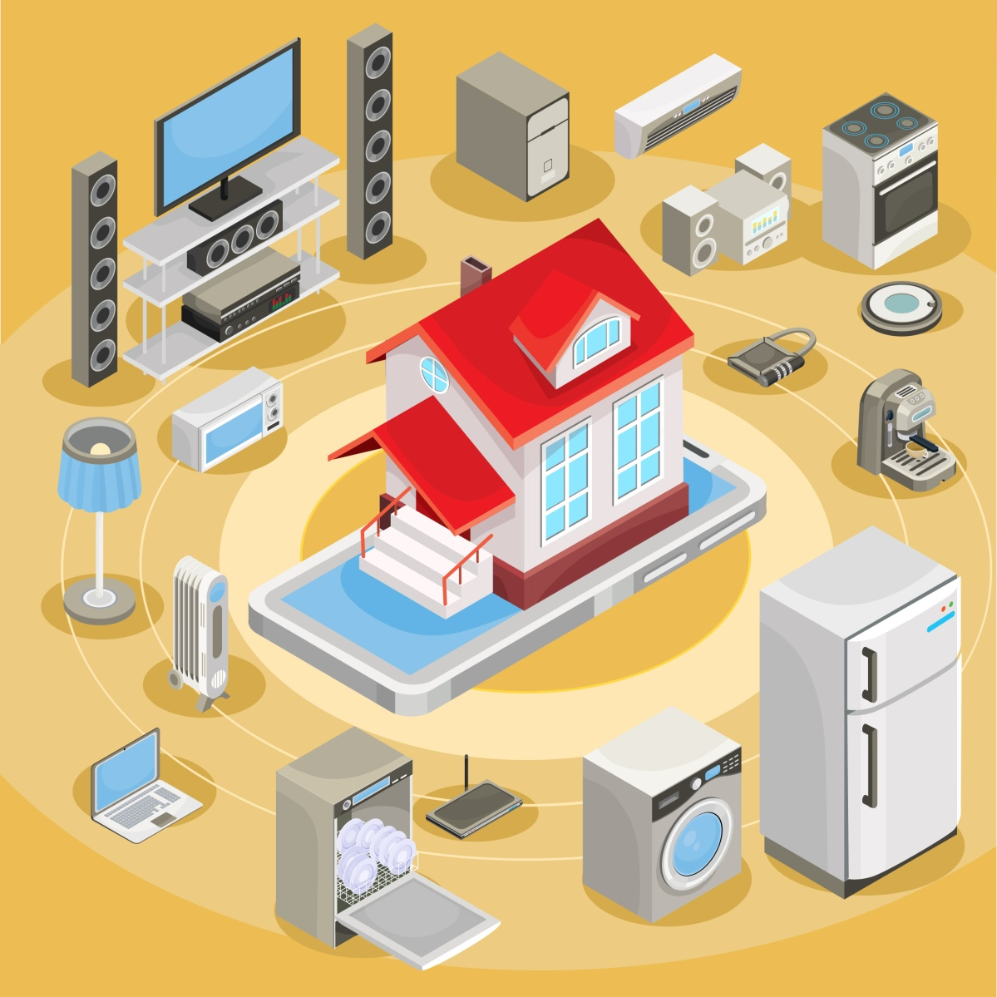
Internet of Things
Pervasive presence around us of a variety of things
RFID tags
Sensors
Actuators
Mobile phones
Unique addressing schemes
Ability to interact and cooperate to reach common goals
Notes:
Tipologie più disparate, sono in grado di interagire e cooperare per raggiungere specifici obiettivi. Nel seguito ne vedremo alcuni

Slide 8
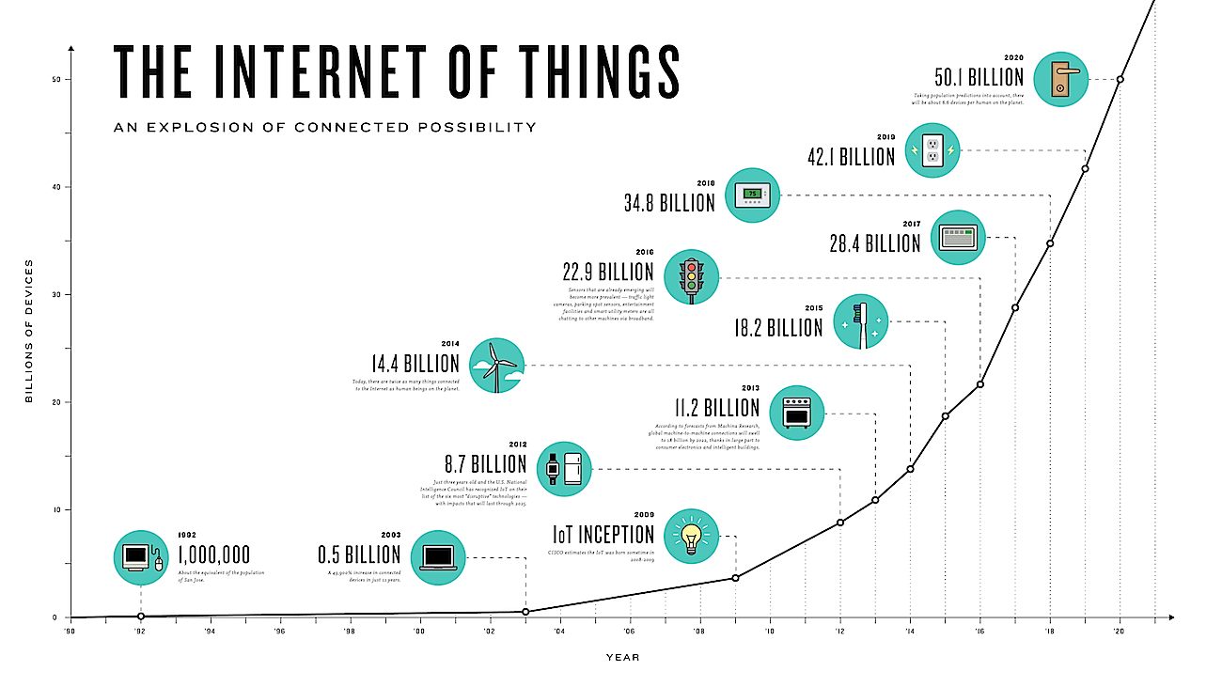
Internet of Things (source: CISCO)
Notes:
I numeri su questo molto diversi tra loro ma tutti concordano sul fatto che saranno incredibili, alcuni dicono impatto più grande di internet stesso. CISCO ha aperto una divisione IoT. M2M communication

Slide 9
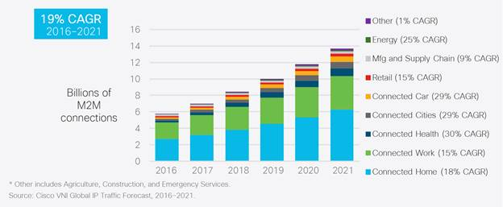
M2M communications (source: CISCO)
Notes:
I numeri su questo molto diversi tra loro ma tutti concordano sul fatto che saranno incredibili, alcuni dicono impatto più grande di internet stesso. CISCO ha aperto una divisione IoT. M2M communication

Slide 10
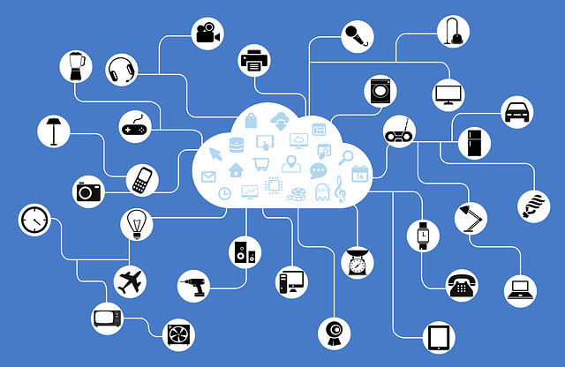
Two complementary worlds
Cloud
IoT
Deployment
Reachability
Components
Computational Capability
Storage
Role of the Internet
Big Data
Centralized
Pervasive
Ubiquitous
Limited
Virtual resources
Real-world things
Virtually Unlimited
Limited
Virtually Unlimited
Limited/None
Means for delivering services
Point of Convergence
Means to Manage
Source
Notes:
Looking at the basic characteristics of these two paradigms, it’s possible to notice how complementarity at different layers exists:
-for instance, cloud deals with virtual resources while IoT with (physical) real word everyday objects
-Cloud has virtually unlimited resources while IoT has poor resources
-moreover Cloud takes advantages of the Internet for service delivery, while IoT uses it as a point of convergence among things.
SO, even if Cloud and IoT have seen an independent evolution.
several advantages that derive from their integration have been identified in literature.
-From the one hand, IoT can benefit from the virtually unlimited resources of the cloud to compensate its technological constraints.
Or Cloud can offer an effective solution to implement IoT service management and composition through the Internet.
-On the other hand, IoT extends Cloud’s scope, with real world things, in a more distributed and dynamic manner, allowing to deliver services in a large number of real case scenarios

Slide 11
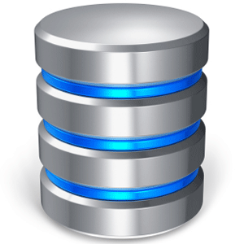
The Need for Integration: Storage
IoT involves
a large set of information sources
a huge amount of non-structured/semi-structured (BIG) data
the need for collecting, searching, accessing, sharing, visualizing this data
Cloud is the most convenient and effective solution to accomplish these tasks
Notes:
So, looking into more detail at the source of the the Need for integration we identified three main aspects:
The first of them is the need for storage
IoT indeed involves a large set of information source, which generate a huge amount of unstructured or semi-structured data
That typically has the characteristics of BIG data
And operations like collecting, searching, accessing sharing or visualizing this data are very common.
In this context, cloud is a convenient and efficient solution to deal with this data
11

Slide 12
The Need for Integration: Computation
Things have limited computational and energy resources
on-site processing not feasible on site
aggregation nodes are needed
Cloud enables
task offloading and energy saving
scalable, real-time, sensor-centric applications
data-driven decisions
AI, ML, prediction algorithms
Notes:
The second aspect that has been identified, is related to computation issues.
Indeed, things have typically very limited computation capability, sometimes related to energy issues.
Hence on-site processing is not possible and one strategy can be the usage of dedicated and more powerful nodes for data aggregation and processing
In this scenario, cloud is an easy way to solve problems deriving from the computational and energy constraints,
Enabling
Task-offloading
And then the development of sensor-centric scalable application that employ prediction algorithms and data driven decision
12

Slide 13
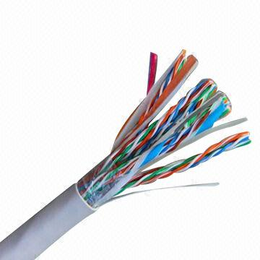
The Need for Integration: Communication
IoT requires devices to communicate (through dedicated hardware)
Cloud offers an effective and cheap solution
to connect, track, and manage
any thing from anywhere at any time
using customized portals and built-in apps
Notes:
The last goal of integration we found is related to communication issues.
IoT typically requires that devices communicate through specific and dedicated hw.
And Support for this communication can be expensive
And in such a context cloud represent an effective solution
For coordinating, tracking and managing things
For instance using customized portals and built-in app
13
13

Slide 14
The CloudIoT Paradigm (Pescapè et al., 2013)
Cloud
IoT
CloudIoT
New opportunities for data aggregation, integration, and sharing
Data-driven decision making for reducing risks and increasing revenue
New capabilities and paradigms

Slide 15
Healthcare
CloudIoT facilitates healthcare best practices and opens the door to innovations
Managing healthcare sensor data efficiently
Reduced need for expertise in technology infrastructures through abstraction of technical details
CloudIoT enables cost-effective, efficient, timely, and ubiquitous medical services
Health information delivery
Health and wellness monitoring
Medical status and disease monitoring
Medication intake monitoring
Rehab
Ambient Assisted Living
…
Notes:
Healtcare: approcci innovativi in ospedale e a casa (AAL) per specifiche patologie, pervasive healtcare, fino a cose più note come le fitness application o quelle per specifiche patologie.
IOT + AI + Big Data
IoT enables healthcare implementation in various settings such as
hospital acute healthcare rehabilitation systems,
long-term supervision of chronic diseases or elderly care (e.g., in nursing homes), and
in-home surveillance such as community healthcare or rural area monitoring that establish a network covering an area around a local community [173, 135, 238, 315].
In more particulars, IoT also allows to implement Ambient-Assisted Living (AAL), where an IoT platform powered by
artificial intelligence address the healthcare of aging and incapacitated individuals in their place of living
in a convenient and safe manner [80, 113, 141].
For instance, these systems advice patients and alert in real time doctors about their movements, changes
of their vital parameters, or significant variations of environmental conditions, in order to take preven-
tive measures [63, 74].
In more general terms, IoT enables patient remote health monitoring in all its facets: continuous mon-
itoring of physical parameters [74, 245, 190] (also using wearable devices [26]), statistic data genera-
tion and diseases-risk drawing [96], verifying compliance with treatment and medication [135], man-
agement and prevention of diabetes and obesity (e.g., educating to and empowering good nutritional
habits [288, 284] or fitness programs [67, 135]).
CLOUD
In general terms, cloud not only facilitates healthcare best practices, also it opens the door for more innovations to take place [23].
15
15

Slide 16
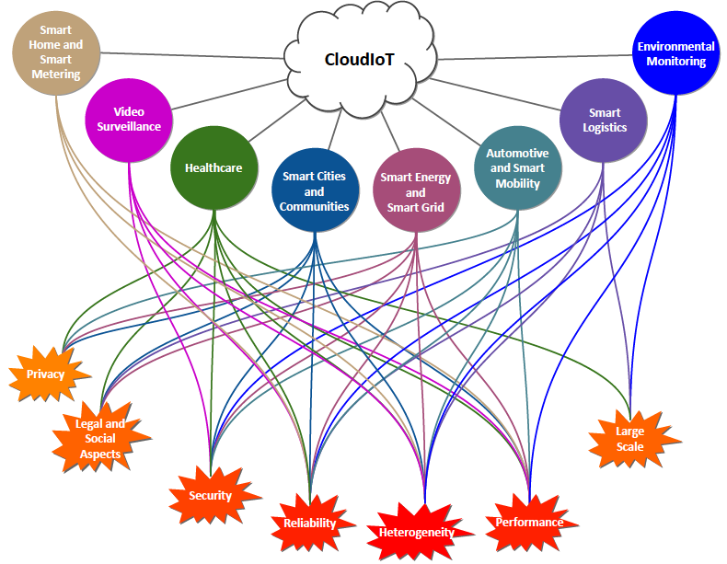
New Applications lead to New Challenges
Notes:
Piattaforme Big Data, sia on-line sia off-line
16
16

Slide 17
Cloud network performance is critical
Without high-performance networks, there would be no such thing as cloud computing
The network can be the bottleneck for computation (e.g. high performance computing, video processing, etc.)
Poor network provisioning can severely compromise user experience

Slide 18
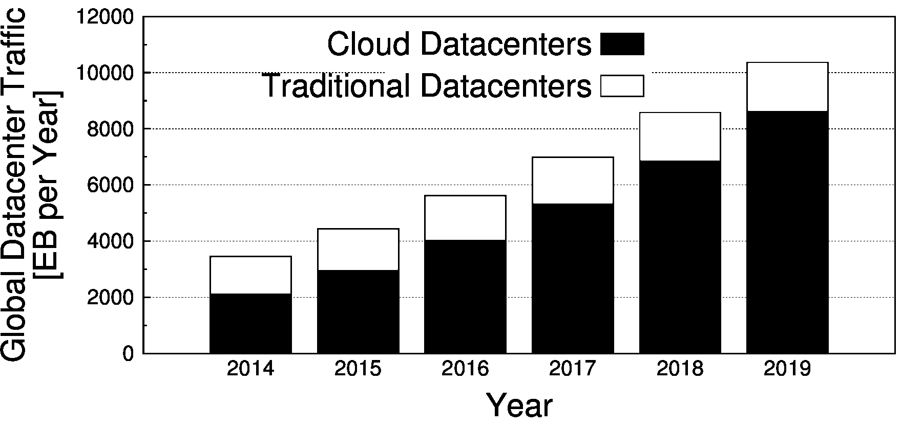
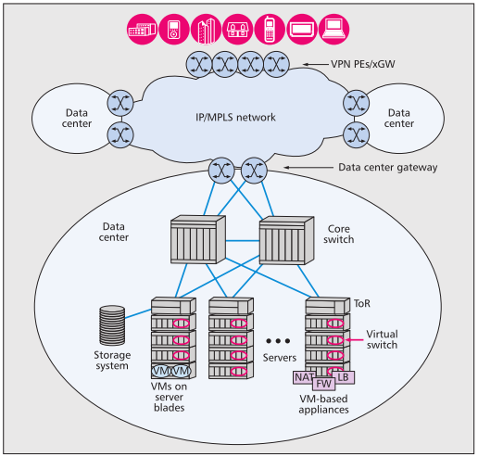
Cloud networks
Cloud traffic is rapidly growing
Since 2008, most of the IP traffic has originated or terminated in a datacenter
More than 75% of datacenter traffic will be cloud traffic by 2018 (Cisco Global Cloud Index)
Public cloud is growing faster than private cloud
Huge investments in cloud networking
15% of datacenter’s total worth
Datacenters and cloud architectures continue to evolve to support increasing adoption
Geo-distributed networks of datacenters are being built
Notes:
La rete si è ampliata anche perché sono nati nuovi grossi datacenter….

Slide 19
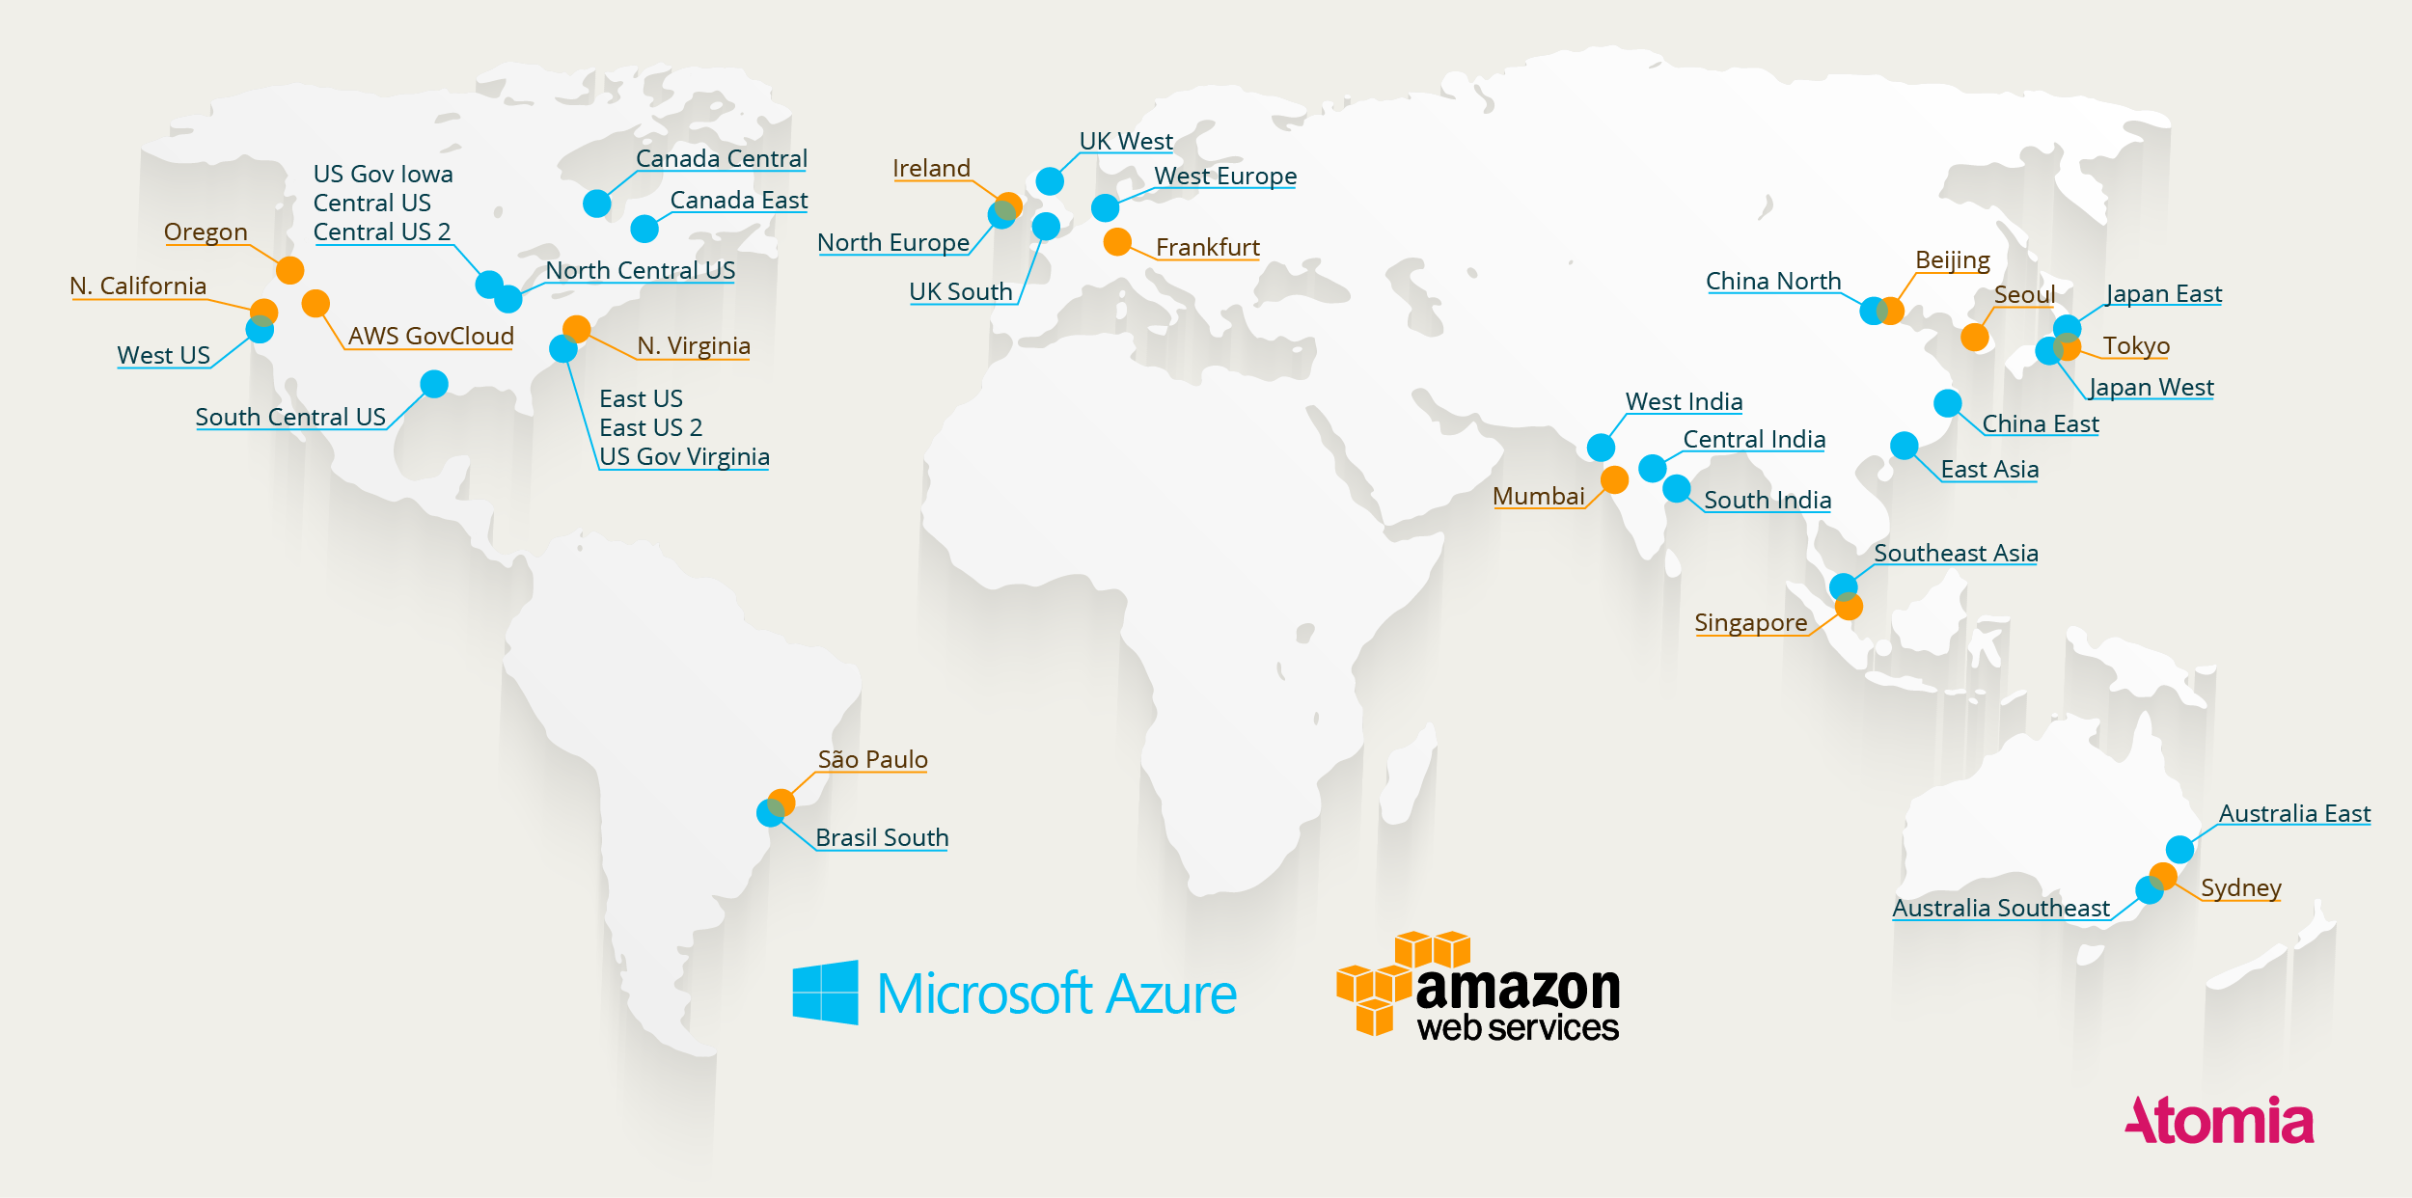
Map of all Azure and AWS Datacenters (end of 2016, source:Atomia)

Slide 20
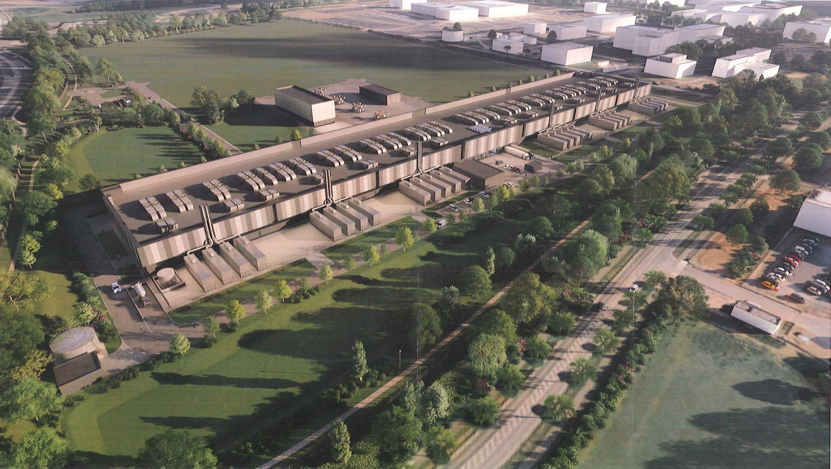
Dublin AWS

Slide 21
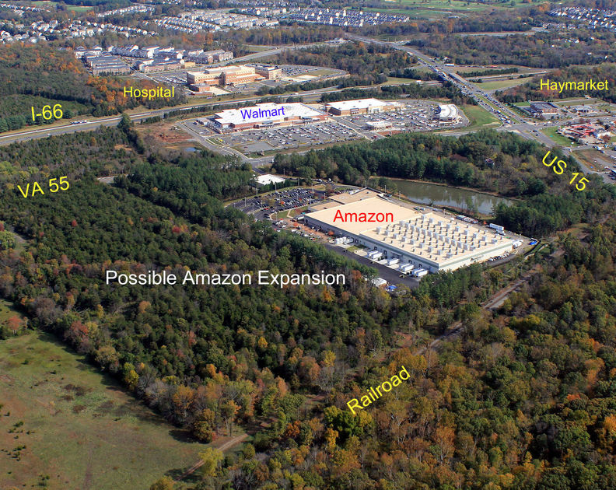
US AWS

Slide 22
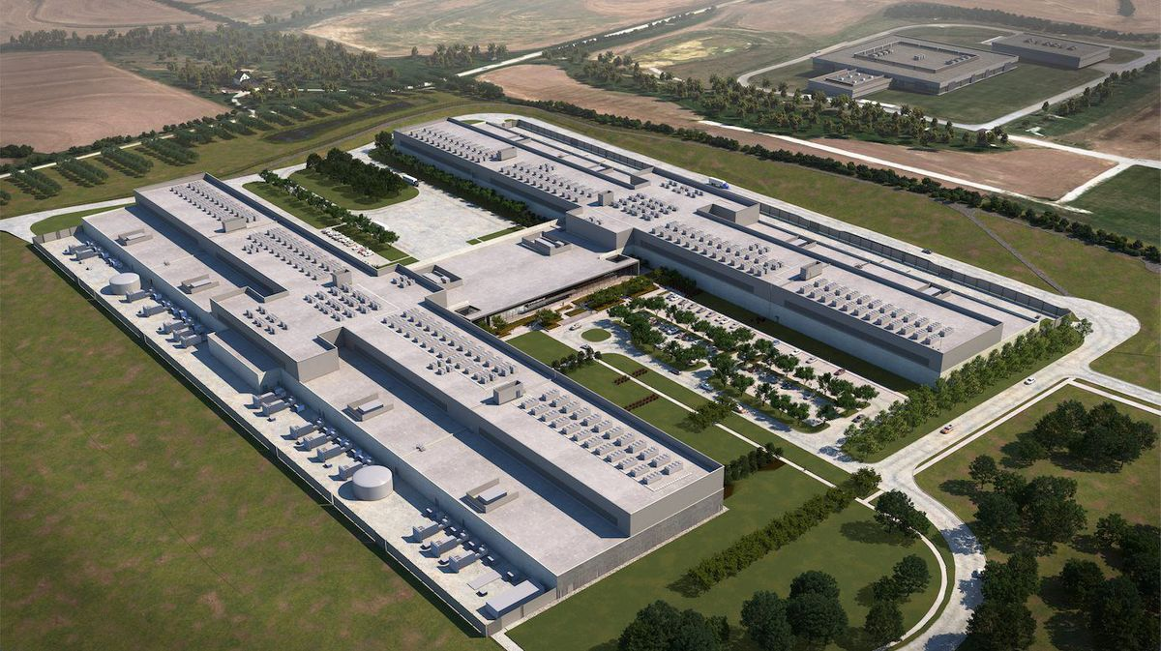
Facebook Datacenter

Slide 23
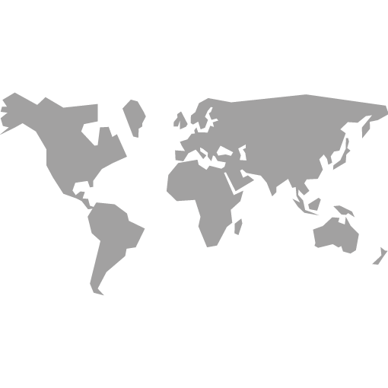
Cloud network taxonomy
intra-datacenter network
inter-datacenter network
cloud-to-user network
EU
US
AP
SA

Slide 24
Cloud network taxonomy
intra-datacenter network
inter-datacenter network
cloud-to-user network
EU
US
AP
SA

Slide 25
Cloud network taxonomy
intra-datacenter network
inter-datacenter network
cloud-to-user network
EU
US
AP
SA

Slide 26
What do we know about cloud networks?
Providers rarely make promises or expose details about the network
Customers have to cope with the limited awareness about cloud networking environments
Performance unpredictability
Performance variability
Non-cooperative monitoring approaches
do not require access to any restricted information
adopt the point of view of the general consumer

Slide 27
Cloud market and experimental activities
Cloud Market
Broad and increasing number of cloud suppliers
Market dominated by a few global providers
Widening gap between the big four cloud providers and the rest of the service provider community
Experimental activities
Leading providers investigated
Amazon Web Services
Micorsoft Azure
TCP and UDP performance
40% of the global market share together
27

Slide 28
Intra-datacenter network performance
The VM size is the factor with the major impact of the throughput achievable
Both M and L Amazon VMs are advertised to have the same (Moderate) network performance
Throughput with M is quite different across providers
Different mangement policies implemented by the two providers
Very similar intra-datacenter performance across different Amazon datacenters
Significant variation is observed for different Azure datacenters
Notes:
Il primo statement I valori (medi: media delle medie su diversi DC); il secondo le error bar.
Non tutti I datacenter Azure sono uguali (regioni), ma il contratto è lo stesso! Ma….

Slide 29
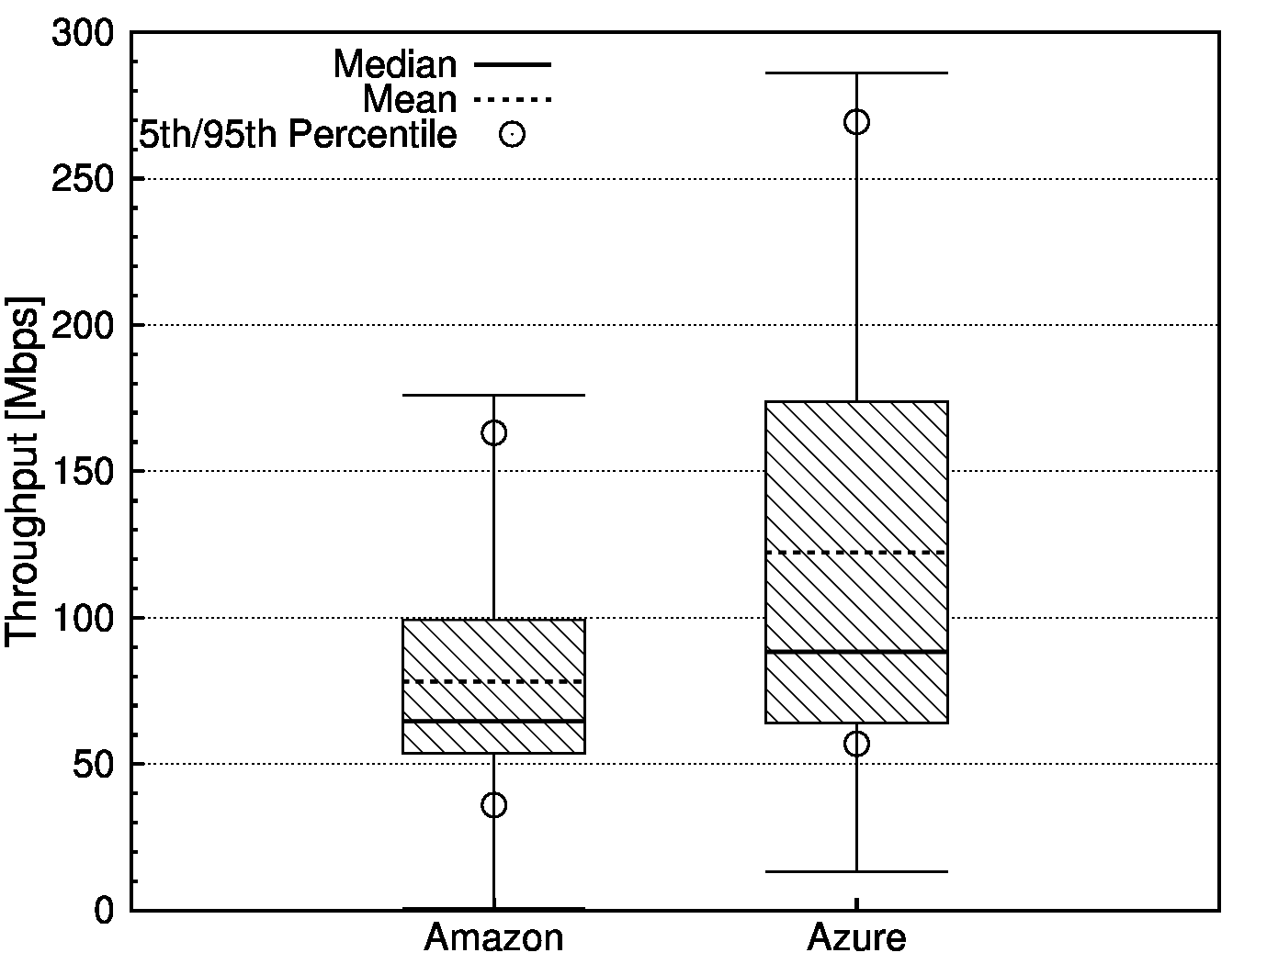
Inter-datacenter network performance
Azure infrastructures perform better in terms of TCP throughput (+56%, on average)
Inter-datacenter and intra-datacenter performance figures are comparable in terms of TCP achievable throughput
Notes:
TCP di tutte le VM size, di tutte le regioni (6 coppie, 12 considerando i versi)
Prestazioni di reti INTRA

Slide 30
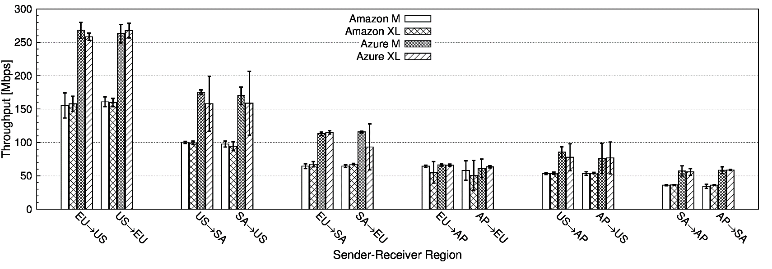
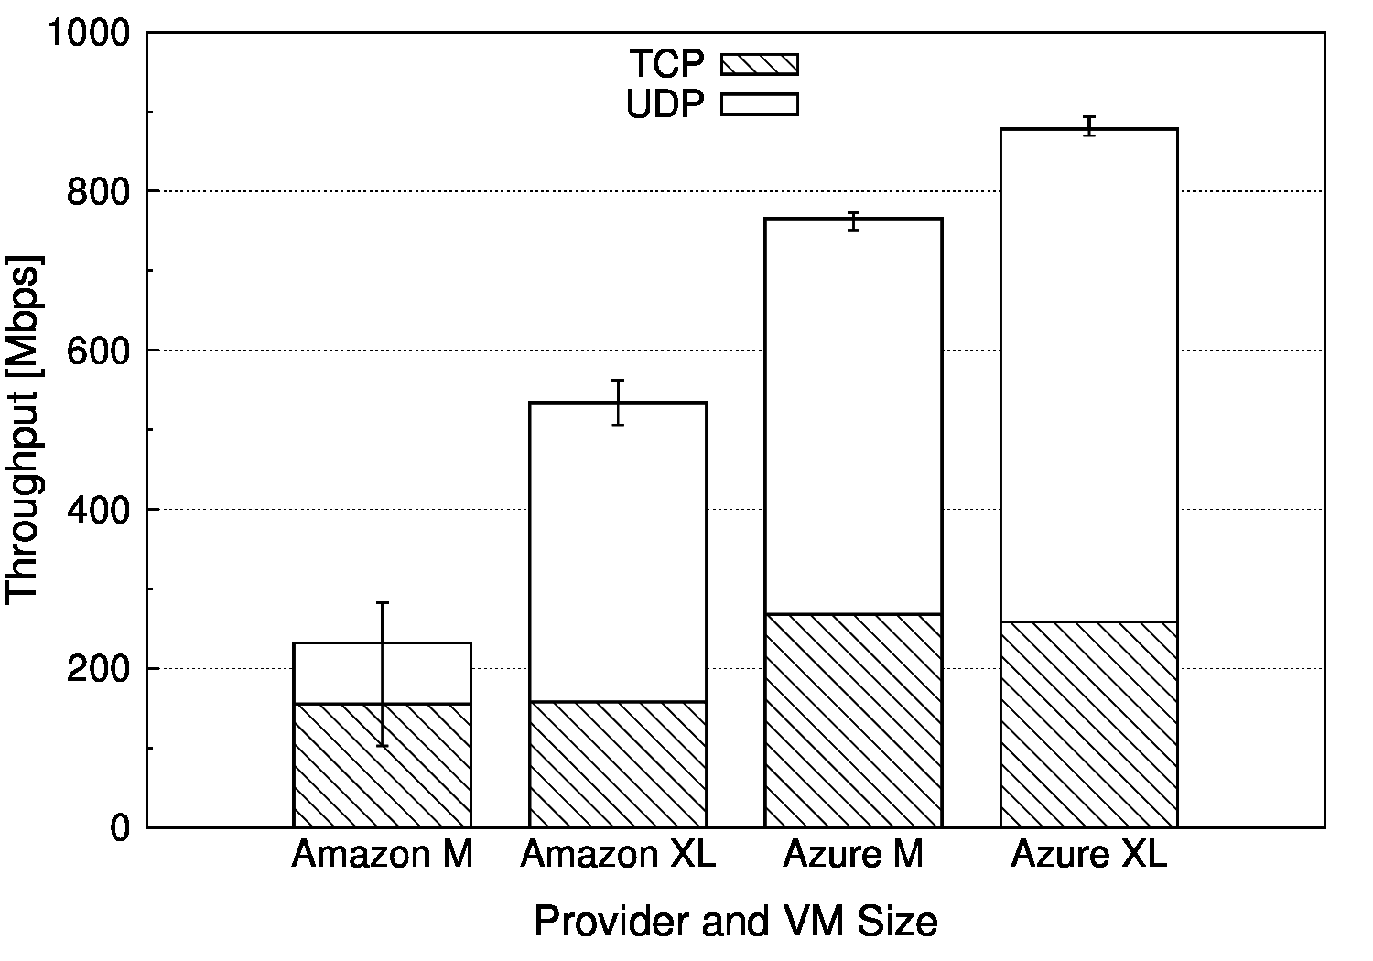
Inter-datacenter network performance
VM size
doesn’t impact TCP performance
impacts UDP performance
Azure is better in terms of UDP too
Notes:
L’infrastruttura di rete ha un impatto importante: vedere le prestazioni di US – SA e US – EU, non è quindi un problema di distanza ma entrano altri fattori.

Slide 31
Inter-datacenter network performance
Deployed network infrastructure impacts performance e.g., performance does not follow distance (US/SA – US/EU)
Worse performance associated to regions with higher costs for the customers
Notes:
Higher costs for customers are in AP e SA

Slide 32
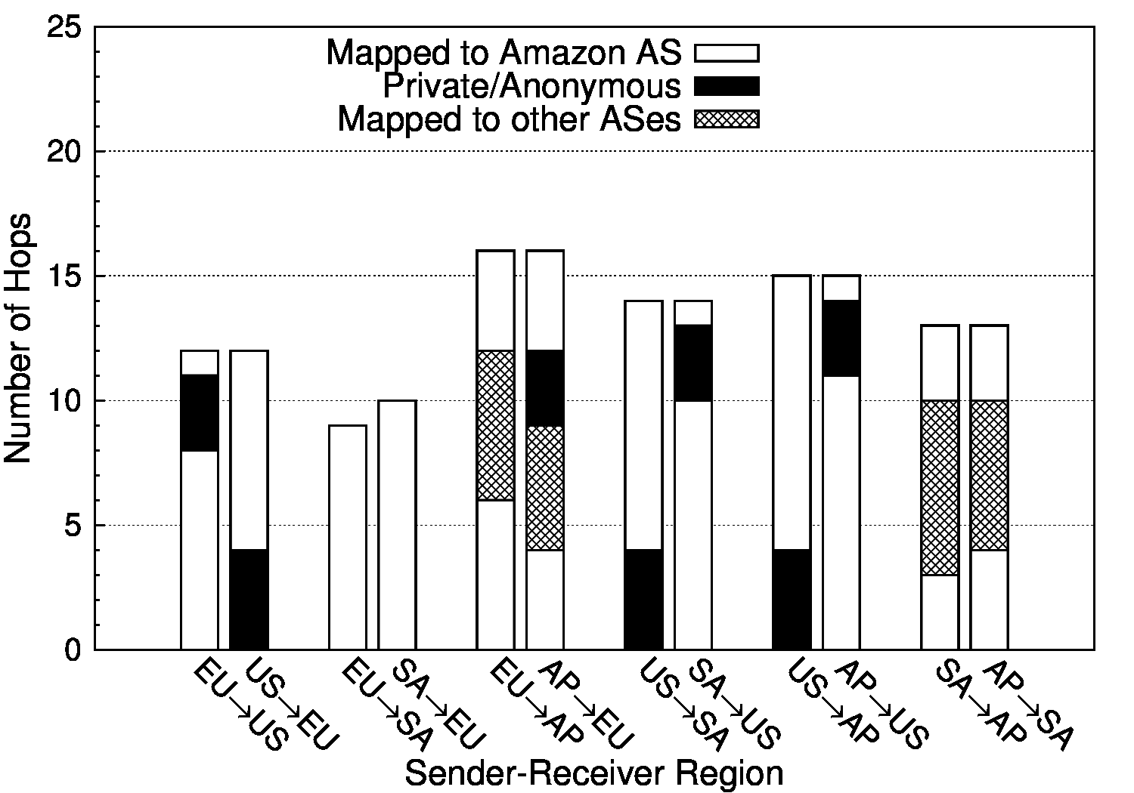
Inter-datacenter network performance
In the case of AWS
best performance is achieved with “proprietary” networks
worst performance is related to
Non-proprietary networks
Higher costs for customers
Notes:
Higher costs for customers are in AP e SA

Slide 33
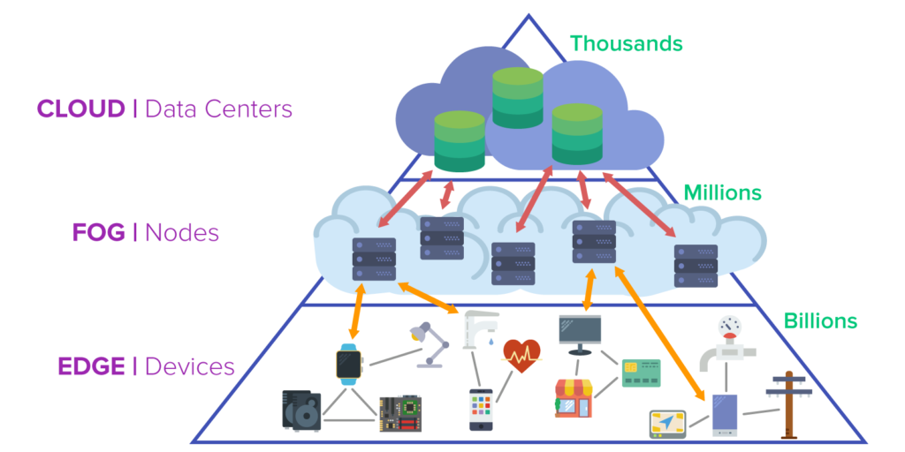
Ongoing Research: (Mobile-)Edge Computing / Fog Computing
Extending Cloud Computing to the edge of the network
Main features of the Fog
Low latency and location awareness
Wide-spread geographical distribution
Mobility
Very large number of nodes
Predominant role of wireless access
Strong presence of streaming and real time applications
Heterogeneity
Notes:
The above characteristics make the Fog the appropriate platform for a number of critical Internet of Things (IoT) services and applications, namely, Connected Vehicle, Smart Grid , Smart Cities, and, in general, Wireless Sensors and Actuators Networks (WSANs).

Slide 34
Grazie pescape@unina.it

Slide 35
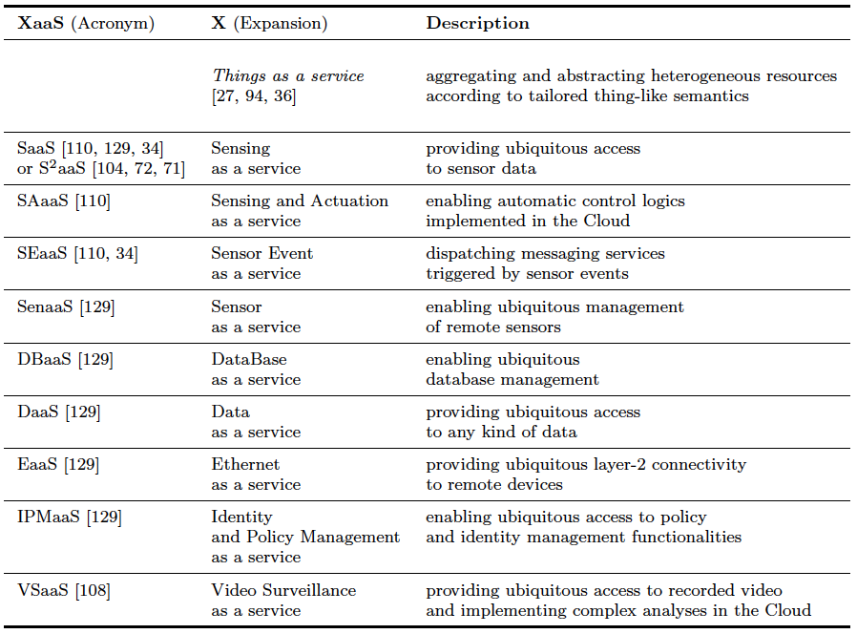
New paradigms enabled by CloudIoT
Everything as Service!
Notes:
The last goal of integration we found is related to communication issues.
IoT typically requires that devices communicate through specific and dedicated hw.
And Support for this communication can be expensive
And in such a context cloud represent an effective solution
For coordinating, tracking and managing things
For instance using customized portals and built-in app
35
35

Slide 36
CloudSurf: a platform to enable the general consumer to monitor public-cloud network infrastructures
Features
Public availability (http://traffic.comics.unina.it/cloudsurf)
Preconfigured or custom experiments
Cost prediction
Result sharing through the community result repository
Main components
Master
Orchestrates the experiments
Cloud probes
Deployed onto the cloud leveraging the IaaS model
Integrate active monitoring tools
Up-to-date Pricing
Information
CloudSurf User
Master
Cloud probe
Virtual machine
Managment API
Results Repository
Cloud credentials

Slide 37
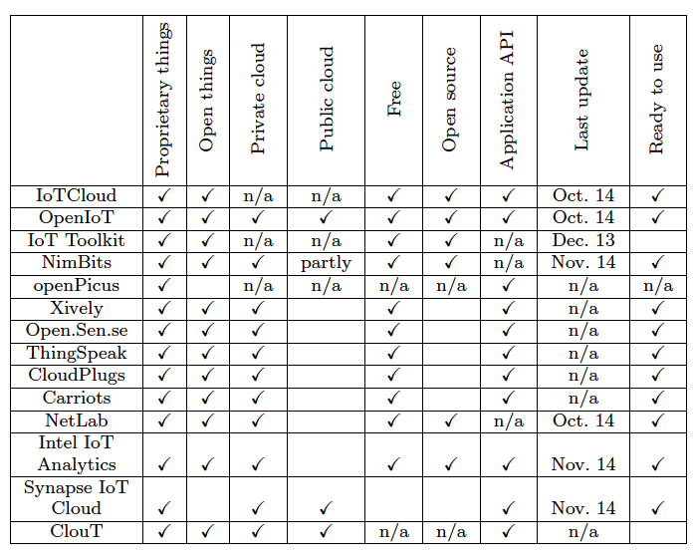
Piattoforme, Servizi e Progetti di ricerca
Notes:
The last goal of integration we found is related to communication issues.
IoT typically requires that devices communicate through specific and dedicated hw.
And Support for this communication can be expensive
And in such a context cloud represent an effective solution
For coordinating, tracking and managing things
For instance using customized portals and built-in app
37
37

Slide 38
Open Issues and future directions
Standardization
Power and energy efficiency
Big Data
Security and Privacy
Integration methodology
Pricing and billing
SLA enforcement
Scalability and flexibility
Network Communications
Notes:
38
38

Slide 39
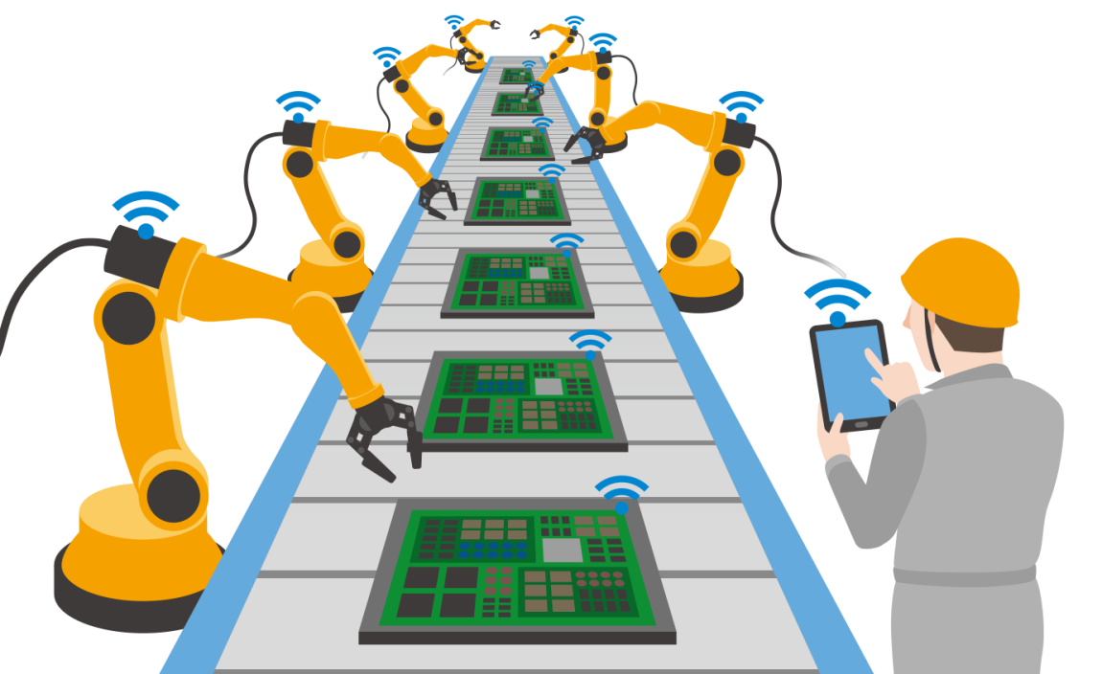
Industry 4.0
ICT-backed automated and interconnected industry
4th industrial revolution, mainly based on
IoT
Cyberphysical systems
Big-data analytics
Cloud Manufacturing
on-demand access to a shared collection of distributed manufacturing resources
temporary, reconfigurable, distributed production lines
Notes:
Healtcare: approcci innovativi in ospedale e a casa (AAL) per specifiche patologie, pervasive healtcare, fino a cose più note come le fitness application o quelle per specifiche patologie.
39
39

