Slide 2
SMART FACTORY
CONCEPT

Slide 3
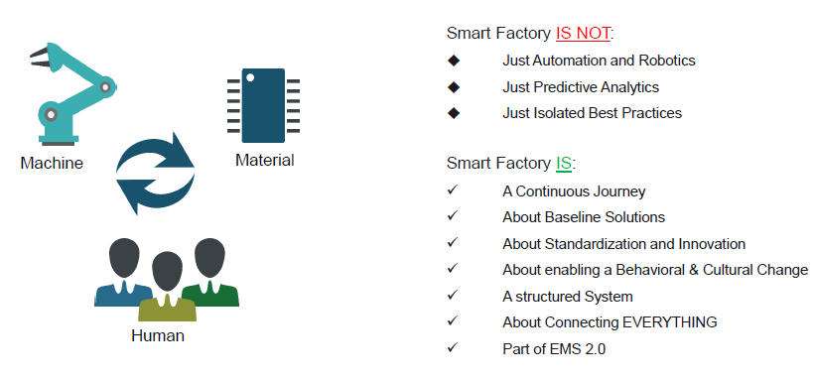
SMART FACTORY
INDUSTRY 4.0 DEFINITION

Slide 4
SMART FACTORY
VISION
Connecting and digitalizing all machines, human and material processes to allow analytics and visualizations enabling self-correction, self-learning and self-optimization.
DIGITALIZATION
VISUALIZATION
OPTIMIZATION
D
O
V

Slide 5
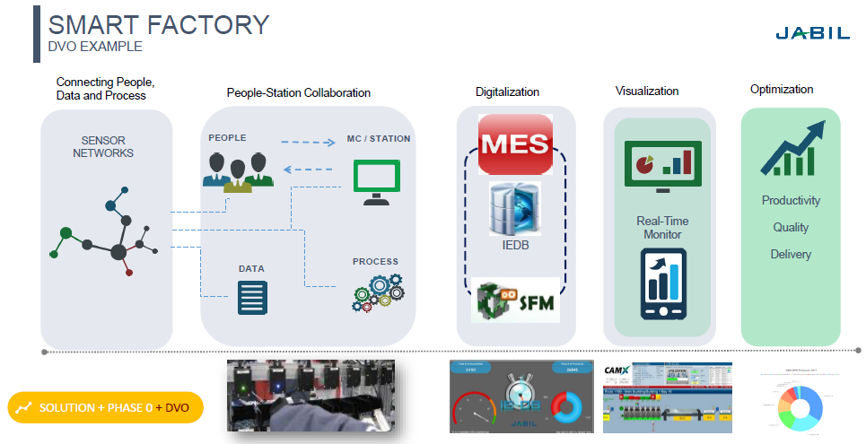

Slide 6
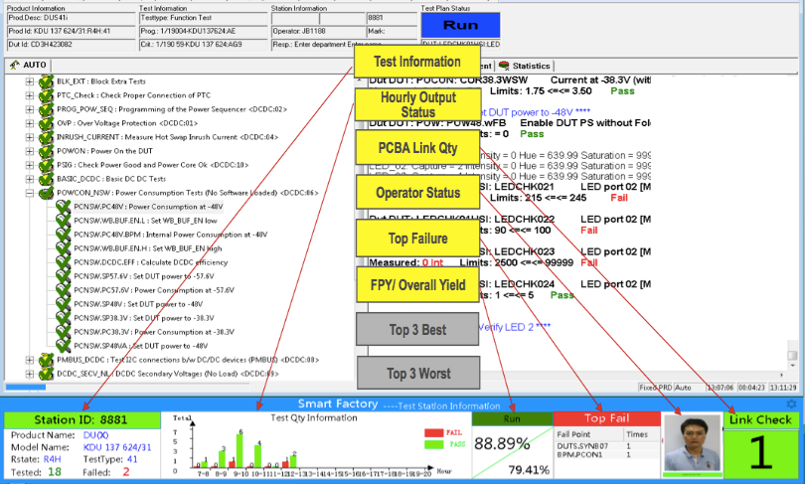
SMART FACTORY
DVO - EXAMPLE
Digitalization, Visualization, Optimization

Slide 7


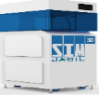

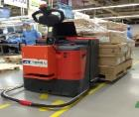


SMART FACTORY
ELEMENTS, PLATFORM, CONTROL, PHASES
People
Manufacturing
Materials
Data
Automation
WCMs
SF
NPI
PMO
ENG
Kitting + OLFS
eMSD + PLC + RTS
Enablers
Planning System
-Data
eDashboards
Platform
EMS 2.0
Talent
SFMS
SFMM
SFIS
SFAS
Phase 0
1.0
SMT
2.0
BACK END
3.0
4.0
WH
BTO/CTO
Phases
+ Customization
+ Customization
+ Customization
Platform: Collection of Baselines
Baseline: Solution to be deployed. A baseline can be “Prescriptive” or “Functionality Equivalent”
Phases: Are related to the area that the baseline is impacting.
Version: Is how we control the releases in a time period and by phase: SMT=1.x, BE=2.x, WH=3.x, BTO/CTO=4.x
FY18
FY16-FY17
FY17
SFMS: Smart Factory Manufacturing Systems
SFMM: Smart Factory Materials Management
SFIS: Smart Factory Information Systems

Slide 8
SMART FACTORY
ROADMAP

Slide 9
SMART FACTORY
SF 1.0 (SMT) + 2.0 (BACK END)
Metrics
Element | Platform | Rev | Deliverables | Enablers | Status
People | NPI PMO | 1.0 | NPI control & management | PLC, Checklist, PM Tool, Gates
 | ENG SME | W1 | Engineering Capabilities | Training, Test, Selection, Project
 | WCMs | S2 | WCMs Capabilities | Training, Case Study, Projects
Mfg | SFMS | 1.0, 1.1 | Process Control | Manufacturing Baselines, IEDB eTool
Data | SFIS | 1.0 | Dashboard | JOS / KPI, eFast
Materials | SFMM | 1.0, 2.0 | Materials Control | Materials Baselines (Euro+America) eDashboard
Automation | SFAS | 1.0 | Mat Logistics Automation | SIM CELL
DEP
OEE
20-40% OEE Improvement
Changeover
15-25% Changeover reduction
Placement
20-30% accuracy improvement
FPY
5-10% FPY improvement
20% Cycle time reduction (BE)
Efficiency
DEP
DEP
DEP
DEP
DEP
DEP
FY16
FY17
 | FY 15 | Q1 | Q2 | Q3 | Q4 | Q1 | Q2 | Q3 | Q4 | FY18
SF 1.0 + 2.0
POCs
Development
Wuxi, GDL & TIS
Deployment
DEP = Deployment
POC = Proof of Concept

Slide 10
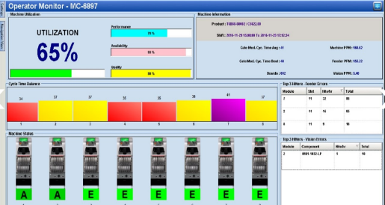
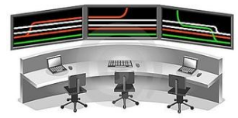
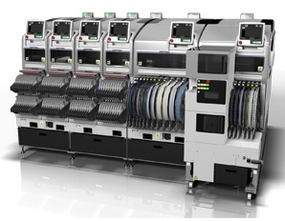
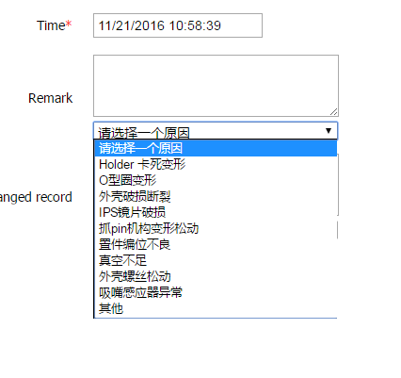
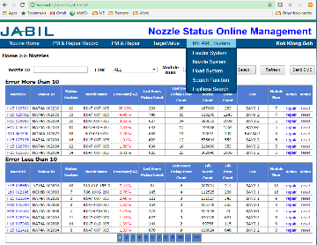


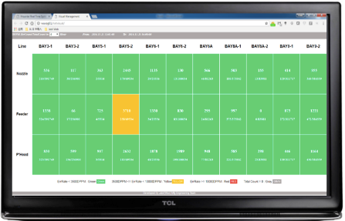
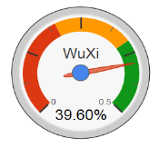
Production Control Center (PCC)
FOCUS AREAS: SELF-OPTIMIZATION
Physical Station
Data
Production Control Center
Standardization
Digitalization
Visualization
(D2) Diagnostic: Why did it happen?
(D1) Descriptive: What is happening?
(P2) Prescriptive: Rules & guidelines
(P1) Predictive: What will happen?
SMEs
Optimization

Slide 11
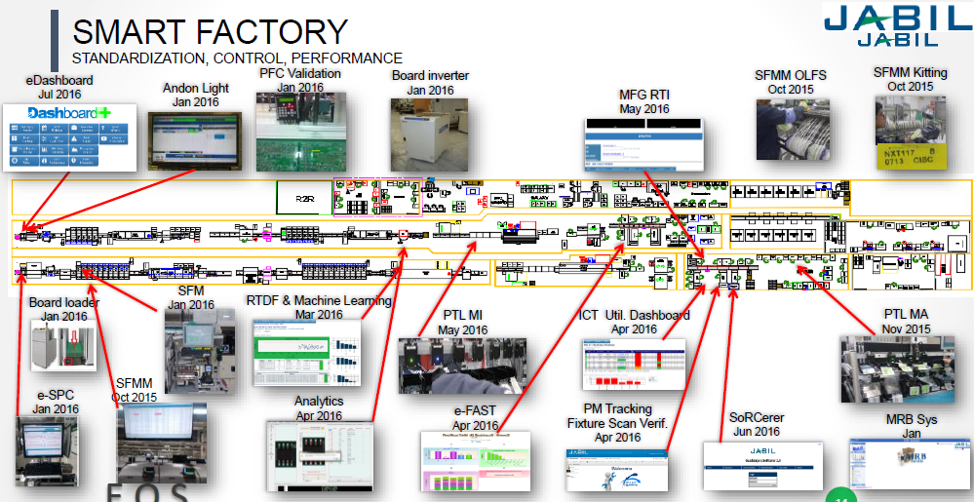

Slide 12
SMART FACTORY
PCC (Production Control Center) SCENARIO

Slide 13
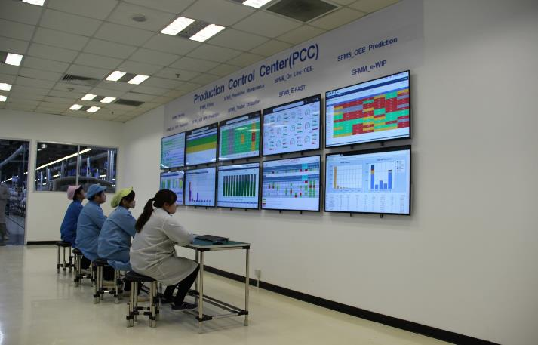
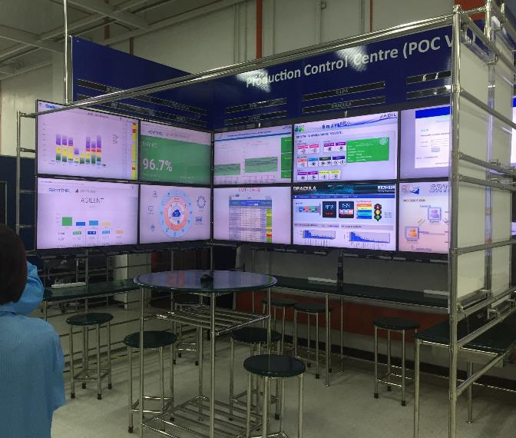
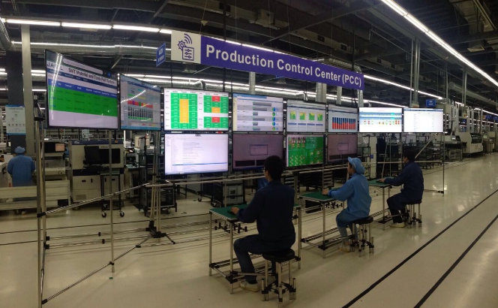
PCC – Production Control Center view (Set up example)

Slide 14
Thank You!

